Slide 1



Hack The Challenge
Your guide to Hackathons & CP

Slide 2
01 introduction
02 hackathons
03 competitive programming
04 discussion

Slide 3
it's that time of the year again – the season of competitions is here

Slide 4
01 introduction
02 hackathons
03 competitive programming
04 discussion

Slide 5
a hackathon is a time-limited event, lasting hours, days, or even months.

Slide 6
teams and individuals build and present innovative projects under a deadline.

Slide 7
do i need to be an IT student?

Slide 8
“your idea is the starting point.”
– Farza

Slide 9
hackathons are open to everyone (developers, designers, idea creators, business, engineering, marketing, …)

Slide 10
teams come together to collaborate intensely on creating and presenting innovative projects.

Slide 11
it’s fun, challenging, and a great way to grow your skills!

Slide 12
"hacking" refers to coding or building a product, not necessarily hacking someone’s account.

Slide 13
turn your knowledge into something practical and impressive.

Slide 14
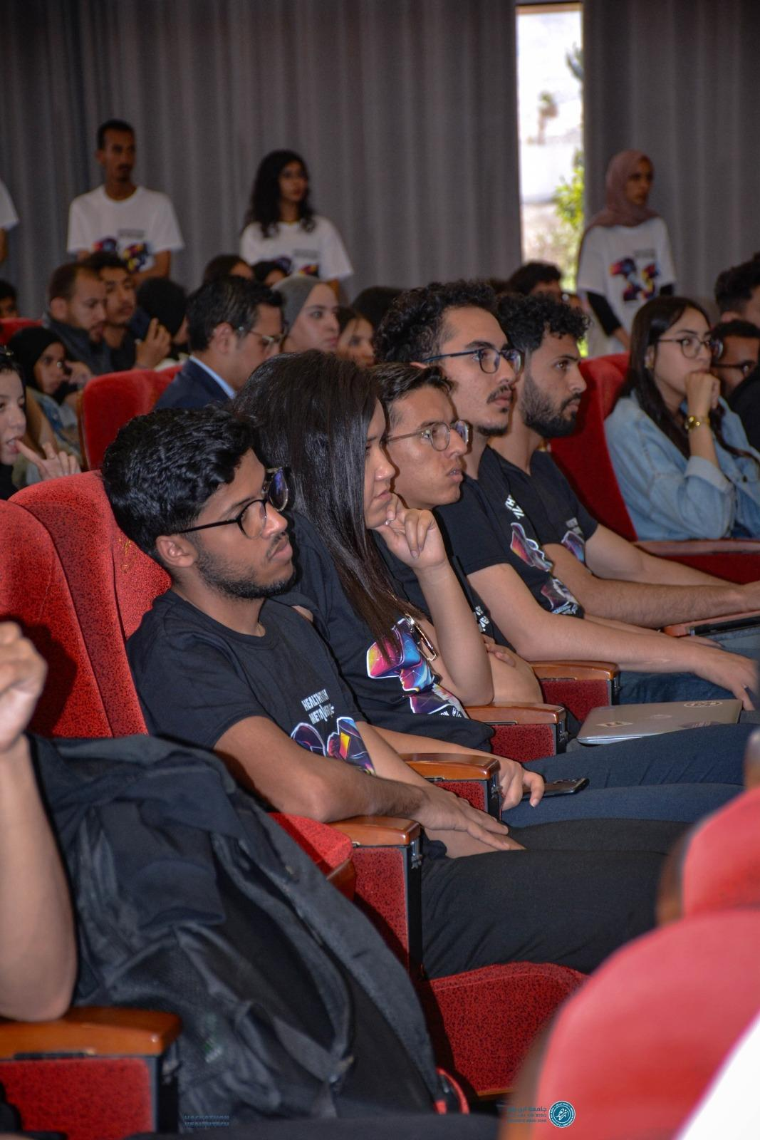
work together, share ideas, and build something amazing as a team.

Slide 15
hackathons connect you with mentors, experts, and future opportunities…

Slide 16
flouuuusss!

Slide 17
pick the right team
focus your idea
create a demo
tell a good story

Slide 18
enjoy…

Slide 19
01 introduction
02 hackathons
03 competitive programming
04 discussion

Slide 20
cp is about solving problems with code!

Slide 21
develop your problem-solving, coding, and algorithm skills.

Slide 22
cp helps you succeed in technical interviews!

Slide 23
it helps you think logically and break problems into smaller pieces.

Slide 24
it trains you to solve problems quickly—because timing matters.

Slide 25
mastering algorithms in cp can make your code efficient and fast..

Slide 26
solve problems on platforms like Codeforces, LeetCode, and HackerRank..

Slide 27
the more problems you solve, the better you get at coding…

Slide 28
01 introduction
02 hackathons
03 competitive programming
04 discussion

Slide 29

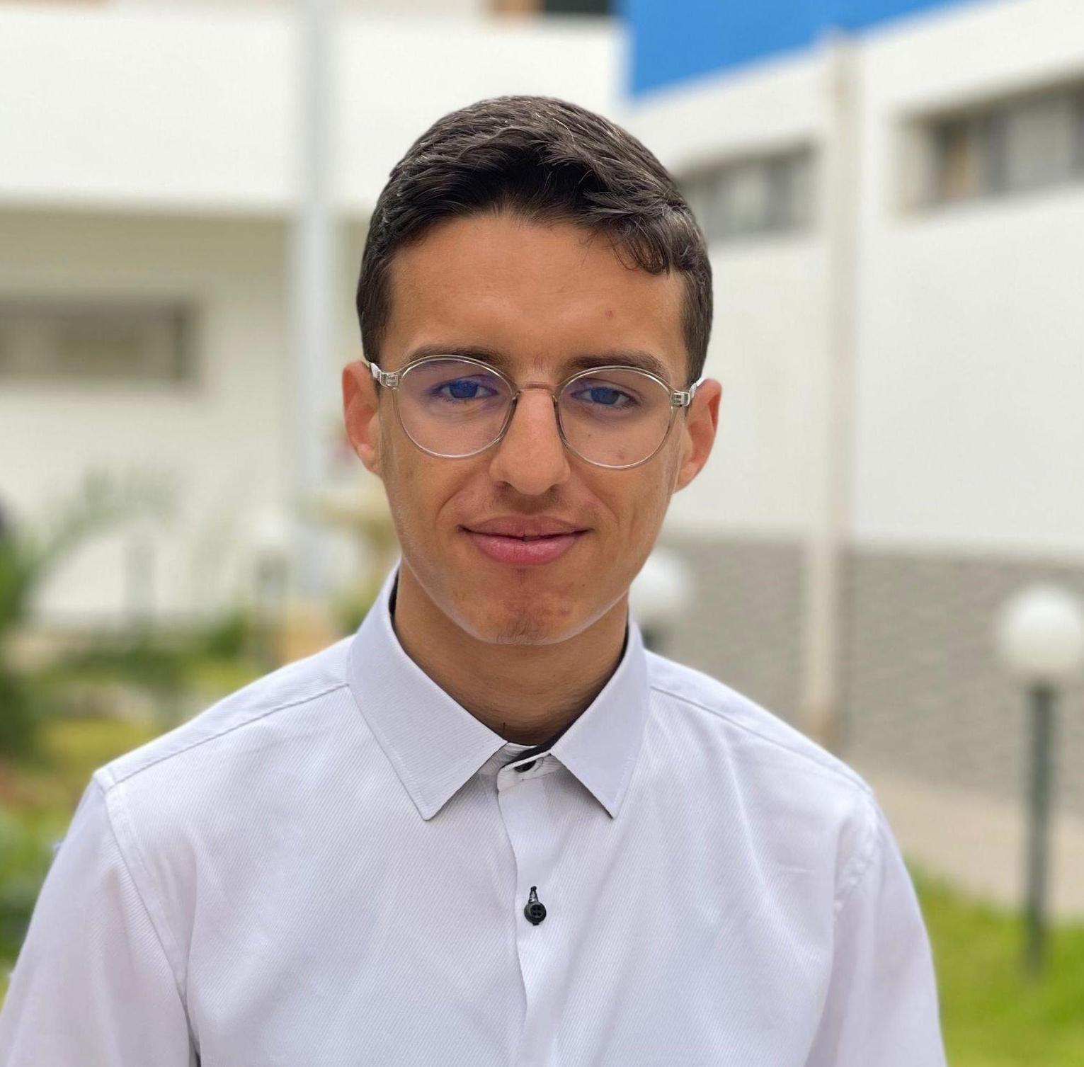
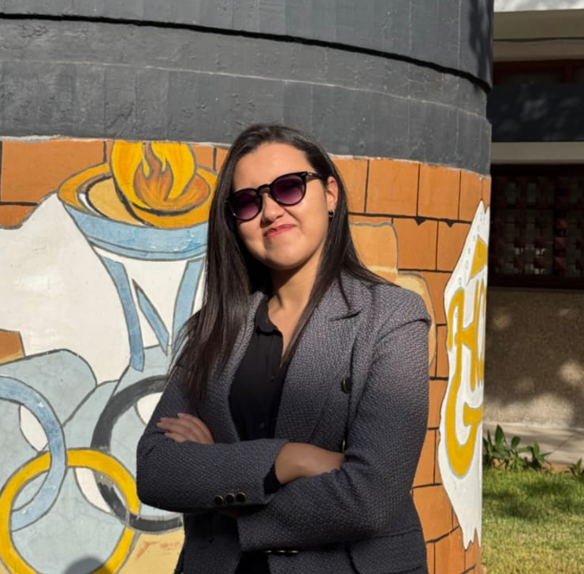
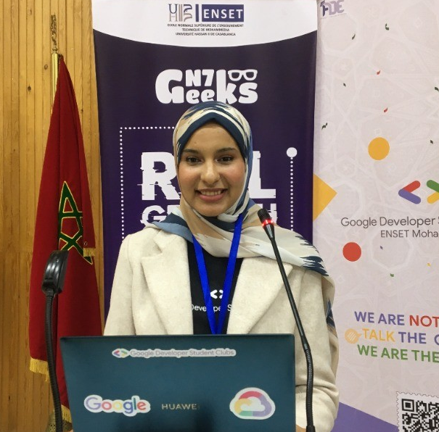
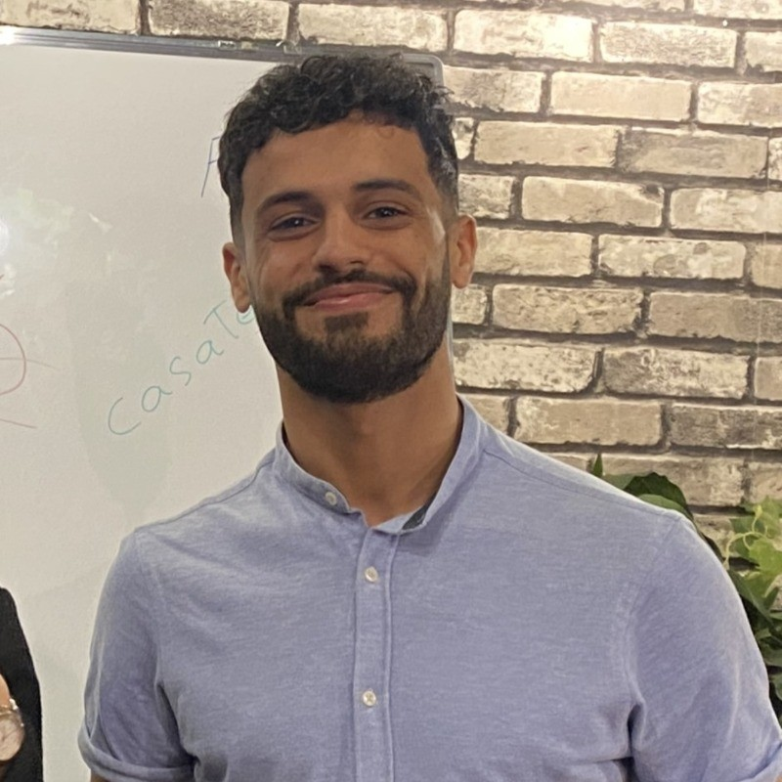
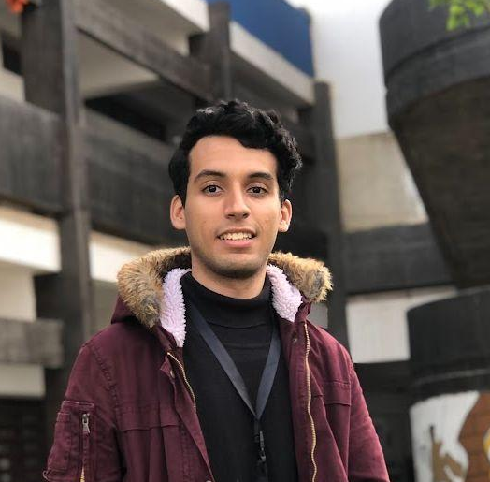
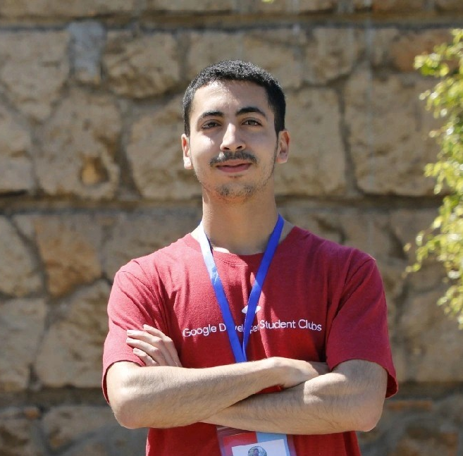
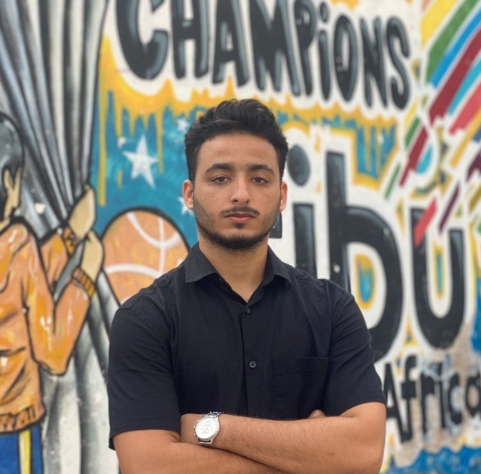
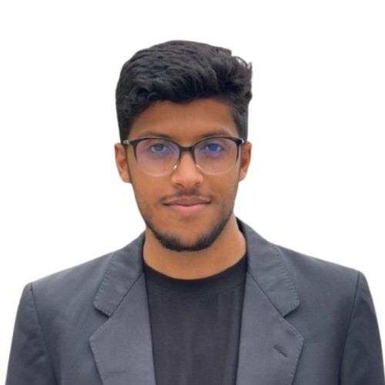
الأساطير..
Brahim EL HOUBE
II-BDCC 3
Nouhayla MOUAKKAL
II-BDCC 3
Khaoula ALLAK
II-BDCC 3
El Bachir Outidrarine
II-BDCC 3
Issam BOUBCHER
GLSID 3
Hamza EL GHAZOUANI
GLSID 2
Mohamed-amine BENHIMA
II-BDCC 2
Ahmed Houssam BOUZINE
II-BDCC 3

Slide 30
if only…

Slide 31
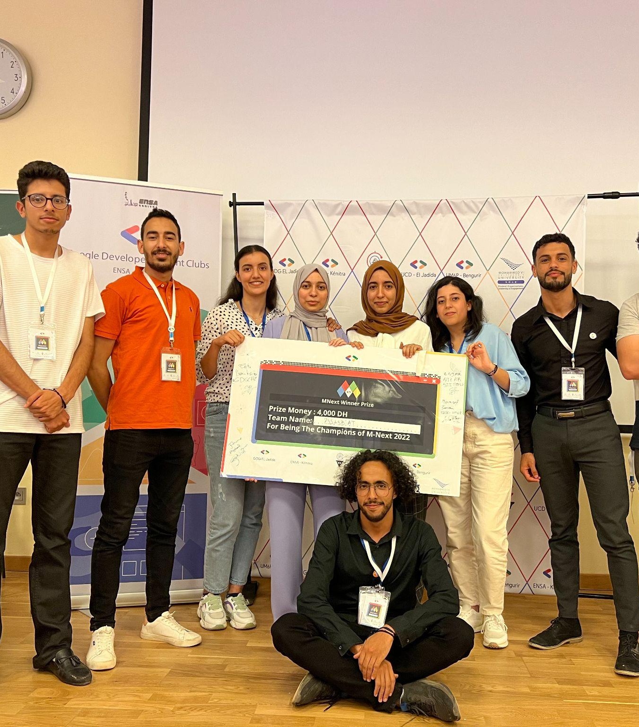
Je tiens à vous remercier pour tout ce que vous avez fait pour moi et à m'excuser encore pour cette situation
if only… i knew this before

Slide 32
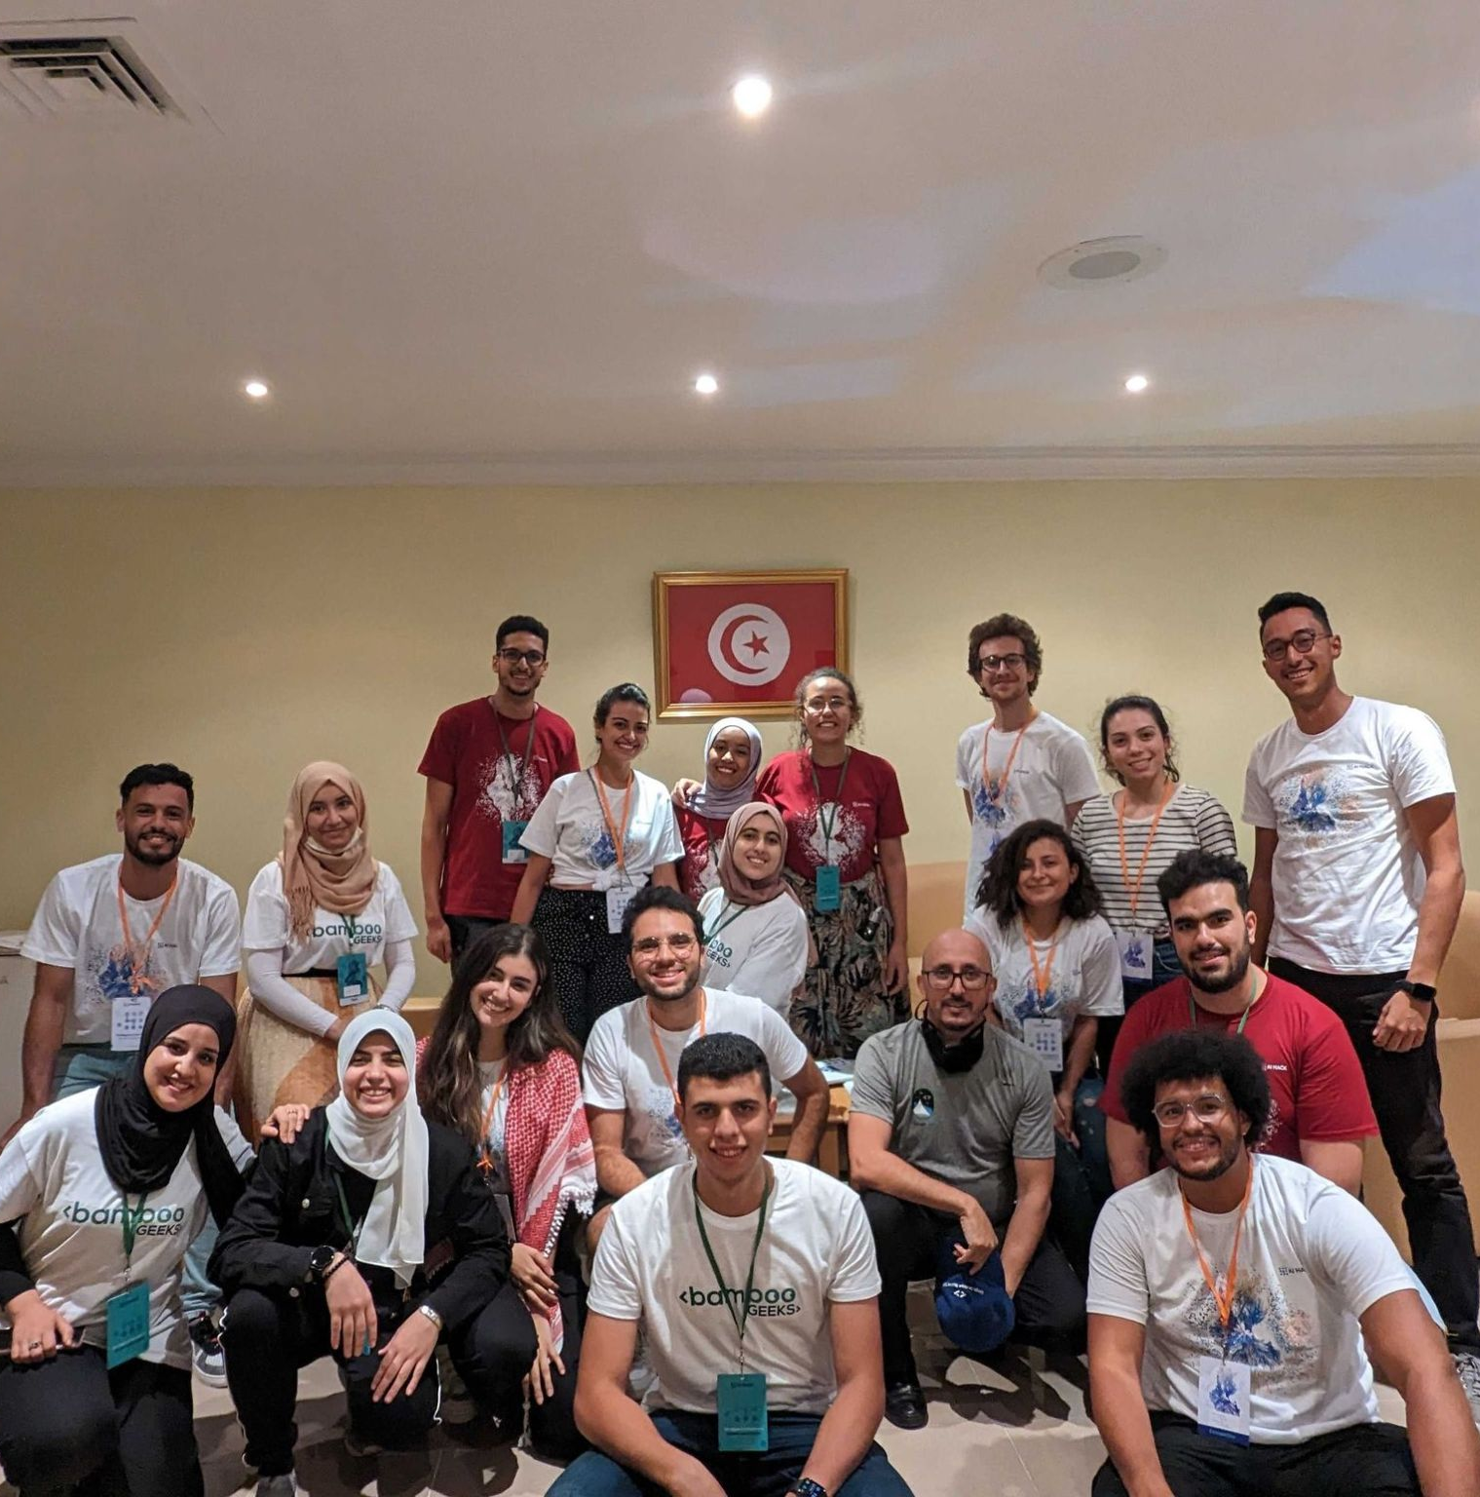
Je tiens à vous remercier pour tout ce que vous avez fait pour moi et à m'excuser encore pour cette situation
connect with people
machy LinkedIn Connect :)

Slide 33
my environment sucks, no hackathons :(

Slide 34
well…

Slide 35
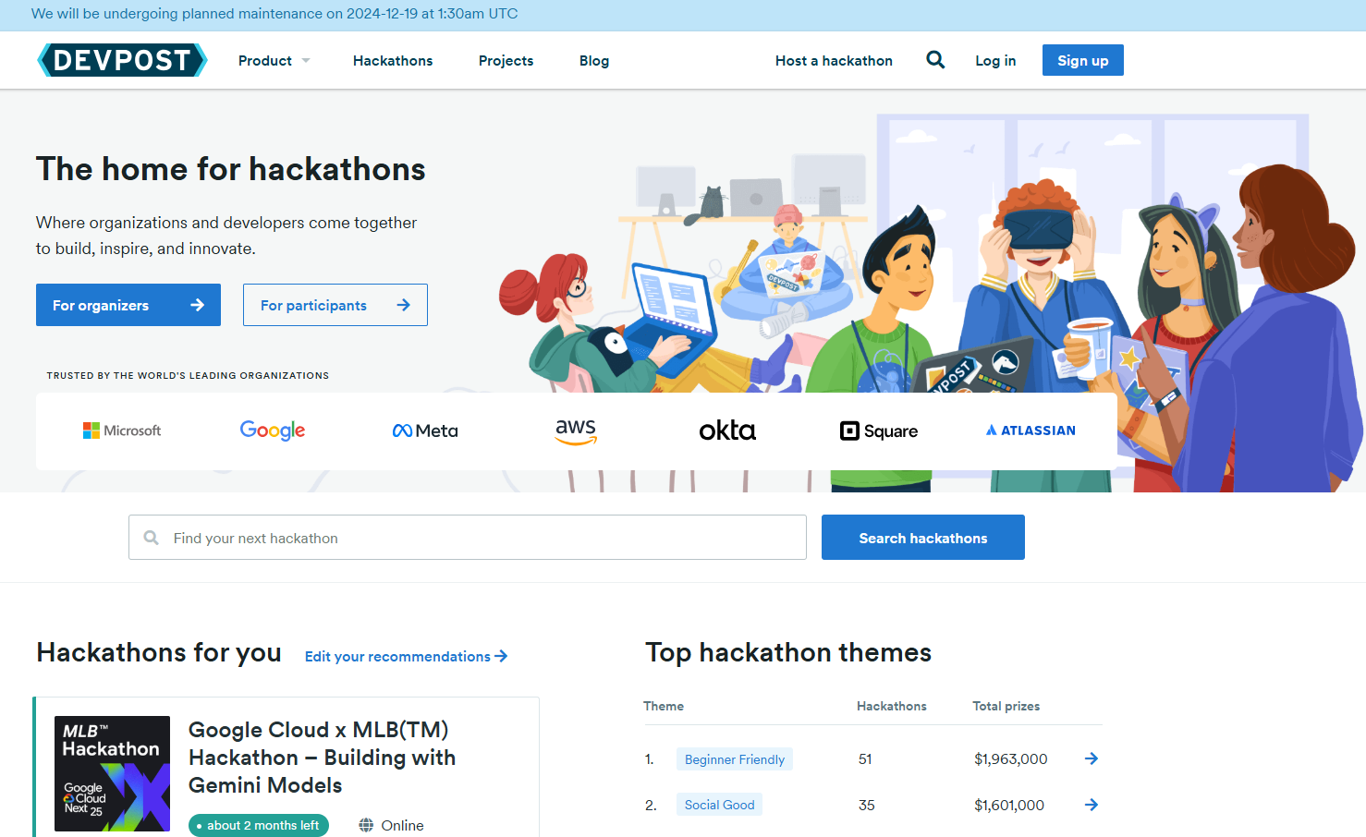
Je tiens à vous remercier pour tout ce que vous avez fait pour moi et à m'excuser encore pour cette situation
Think again :)

Slide 36
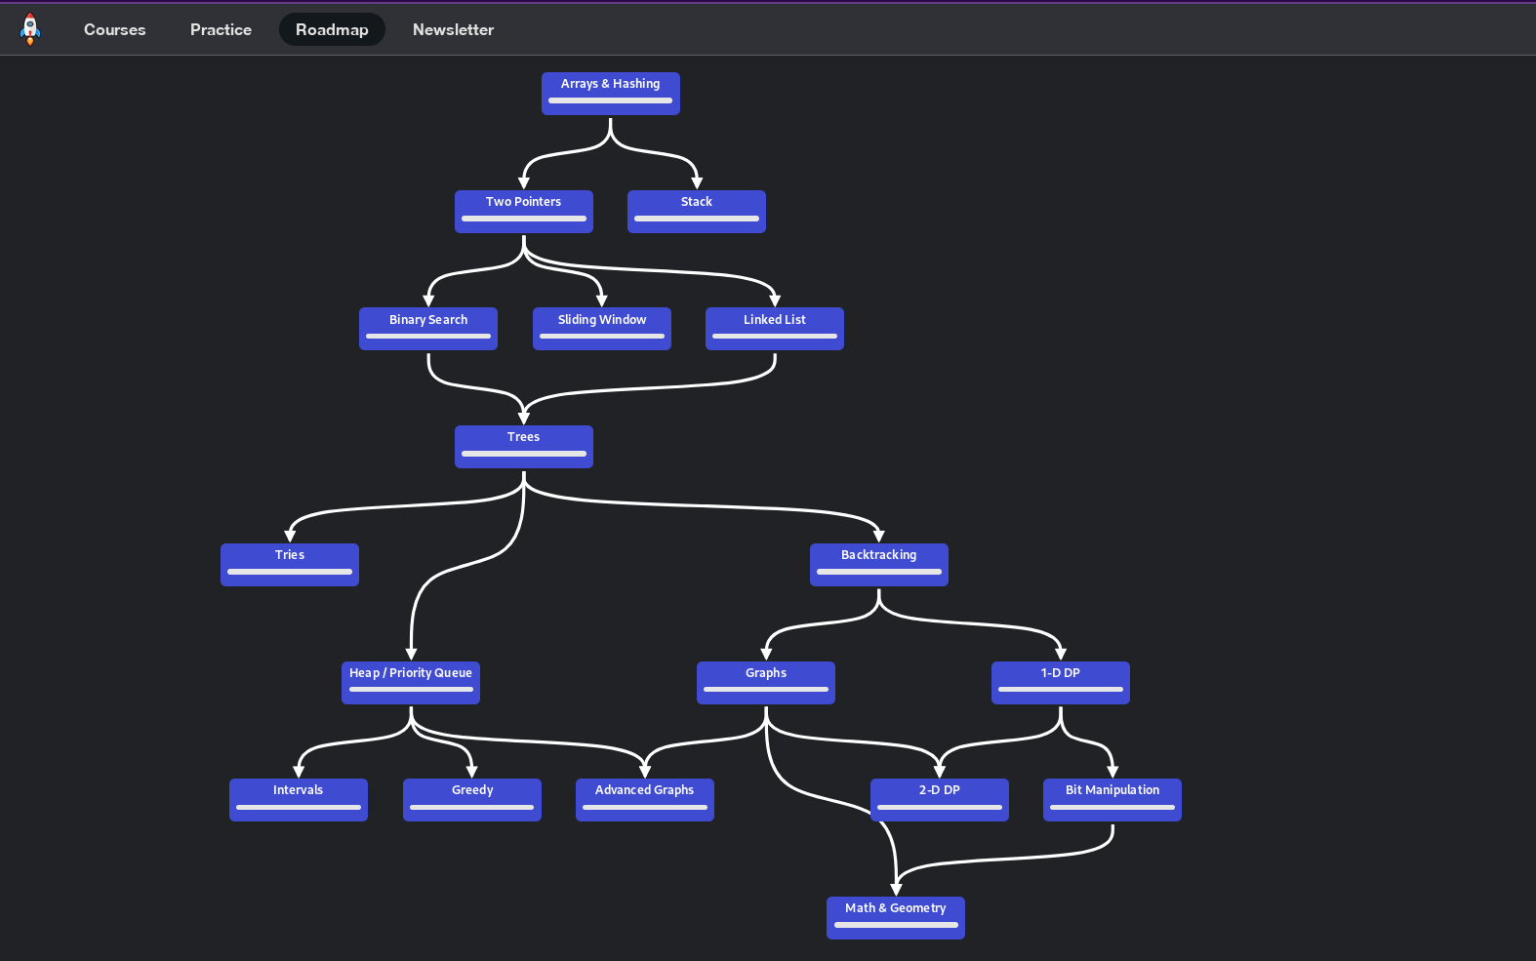
neetcode roadmap

Slide 37
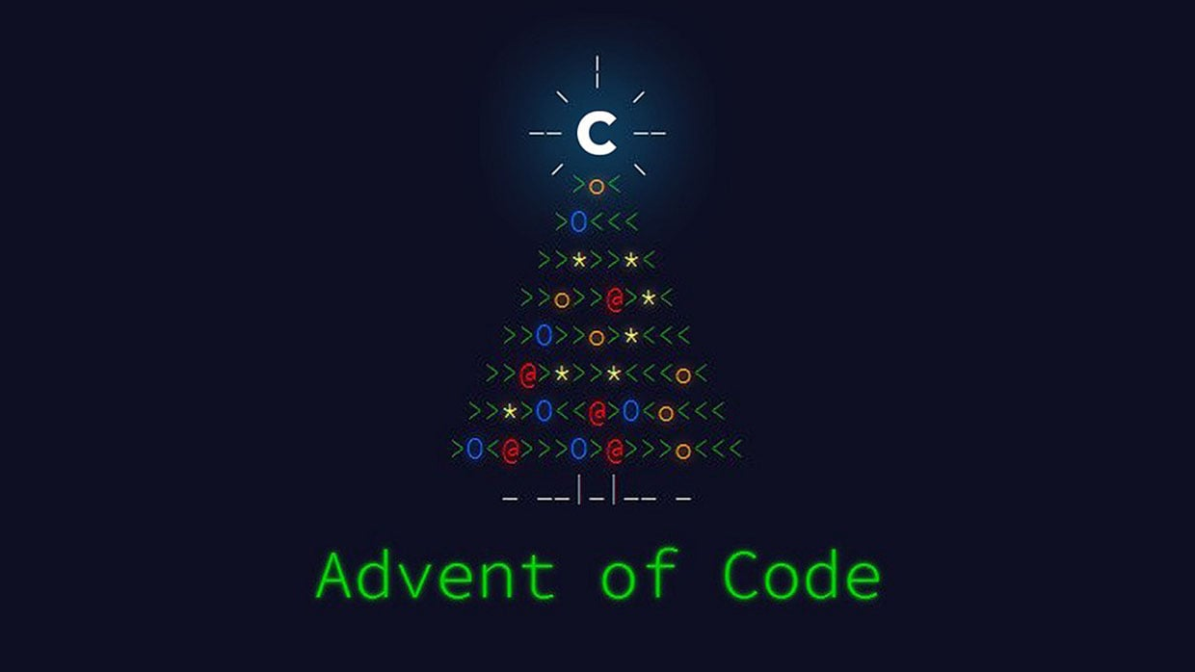

Slide 38
It’s ok to be a beginner

Slide 39
thank you!

Slide 40
